Slide 1
Instructions to RUN the files

Slide 2
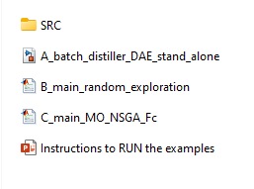
Files Overview
SRC: This folder encapsulates all necessary source code and requisite libraries required to execute our scripts.
A_batch_distiller_DAE_stand_Alone: This is a SIMULINK file enabling standalone model execution, providing user accessibility to manipulate input variables.
B_main_random_exploration: This script executes Latin Hypercube Sample combinations, facilitating numerous simulations, with the ultimate objective of identifying non-dominant sets.
C_main_MO_NSGA_Fc: This script employs the NSGA-II algorithm, paving the path to locating the Pareto Set via multi-objective optimization techniques.

Slide 3
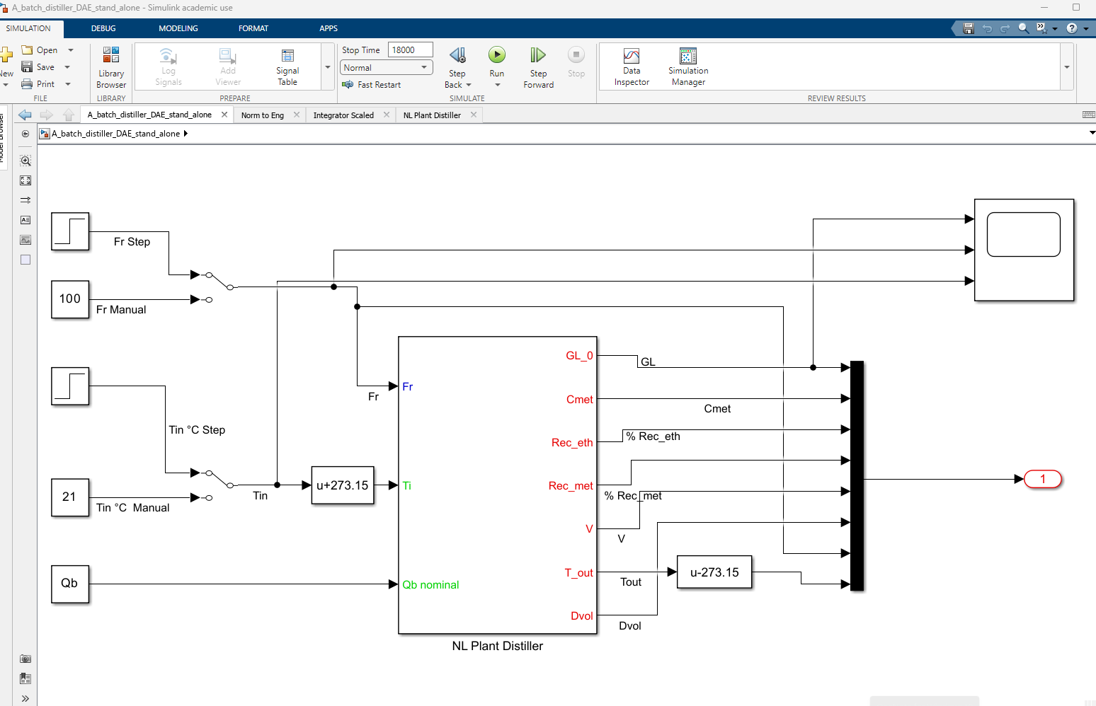
A_batch_distiller_DAE_stand_Alone
RUN
Just open the simulink and play!
Open Scope
(Graph)
Change
The Inputs!

Slide 4
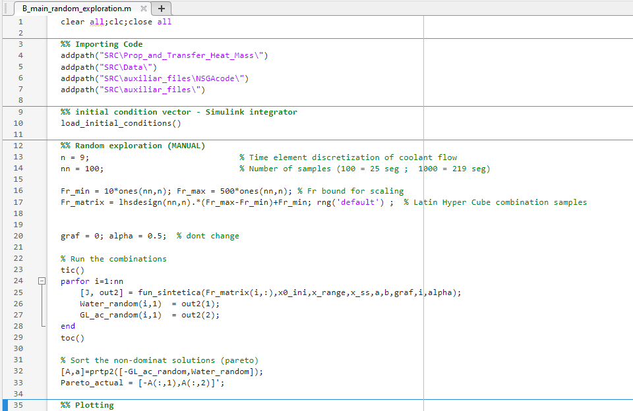
B_main_random_exploration
Here is posible to run a matrix of a latín hyper cube combinations simples.
Change the number of samples nn (at the line 14)
Play (key F5)
See the results and compare with previus reference set.

Slide 5
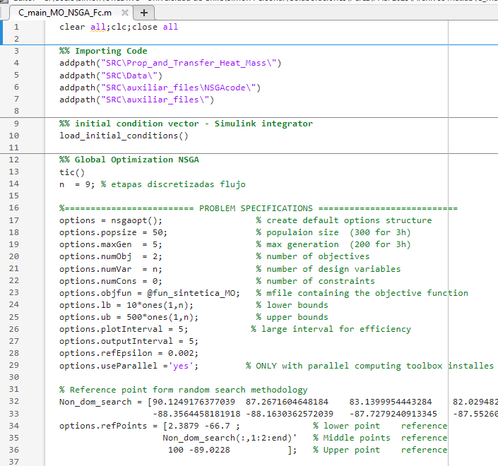
C_main_MO_NSGA_Fc
Here you can customize the NSGA-II algorithm

